Slide 1
HTX Budget 2024 Chatbot
Developed by; Tai Jing Shen

Slide 2
Why is Retrieval Augmented Generation (RAG) Implementation required?
In the context of a Budget 2024 use-case, implementing a Retrieval Augmented Generation (RAG) approach is essential to overcome the limitations of pre-trained language models. While these models possess vast amounts of general knowledge from their pre-training, they lack the ability to access or generate responses based on real-time or highly specific data, such as the details from the Budget 2024 speech. RAG combines the strengths of retrieval-based systems and generative models by:
  Retrieval: Fetching up-to-date information to retrieve the most relevant information ensuring that the responses are accurate and aligned with the source data.
  Generation: After retrieval, RAG leverages the generative capabilities to generate contextually appropriate responses which are both factually accurate and contextually appropriate. This is important because public users may ask very nuanced type of questions about eligibility, policy changes etc.
Notes:
Brief explanation of implementation and rationale

Slide 3




High-level Architecture Diagram
PREPROCESSING
ChromaDB
PDFs From MOF Website
Embedding Model
Encoding
Chunking
Chunk
Chunk
Chunk
Chunk
Knowledge Base (Budget 2024)
Notes:
highlight key components and the flow of information in the system.

Slide 4
Lists of Prompt Interaction with the LLM
Happy path
  ○ Am I eligible for the Majulah Package?
  ○ What are the payouts I can expect to receive in December 2024?
  ○ What are the Key reasons for high inflation over the last two years?
Exception cases

Slide 5
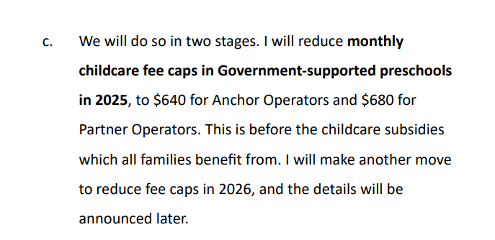
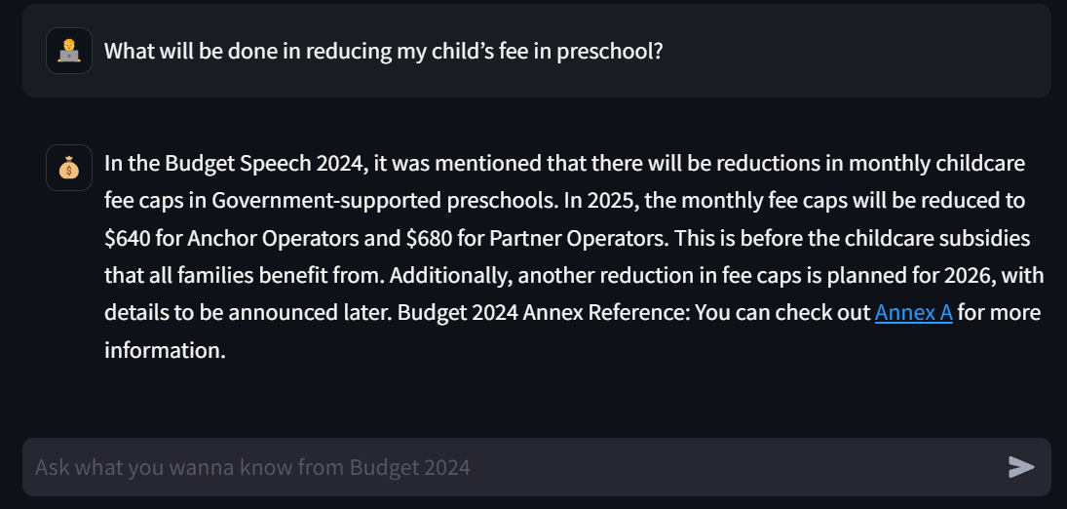
What will be done in reducing my child’s fee in preschool?
Notes:
In the Budget Speech 2024, it was mentioned that there will be reductions in monthly childcare fee caps in Government-supported preschools. In 2025, the monthly fee caps will be reduced to $640 for Anchor Operators and $680 for Partner Operators. This is before the childcare subsidies that all families benefit from. Additionally, another reduction in fee caps is planned for 2026, with details to be announced later. Budget 2024 Annex Reference: You can check out Annex A for more information.

Slide 6
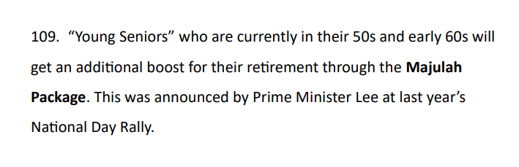
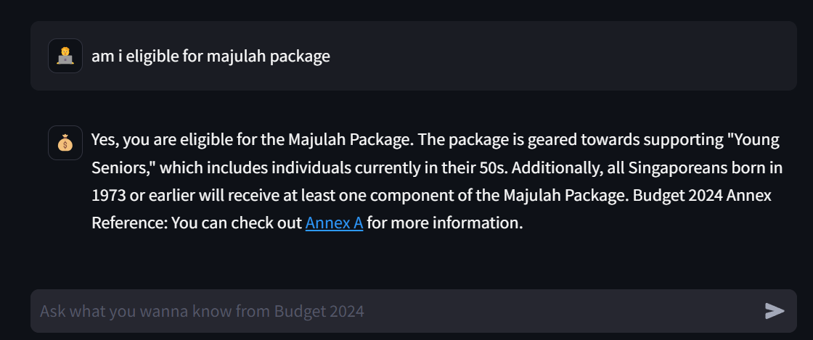
Am I eligible for Majulah Package?
** Assumption was made to user profile to be 52 years old in system prompt to demonstrate the ability to answer.
We assumed that the SingPass information can be retrieved. Else, we can actually design a simple form before starting the chat.
Notes:
Yes, you are eligible for the Majulah Package. The package is geared towards supporting "Young Seniors," which includes individuals currently in their 50s. Additionally, all Singaporeans born in 1973 or earlier will receive at least one component of the Majulah Package. Budget 2024 Annex Reference: You can check out Annex A for more information.

Slide 7
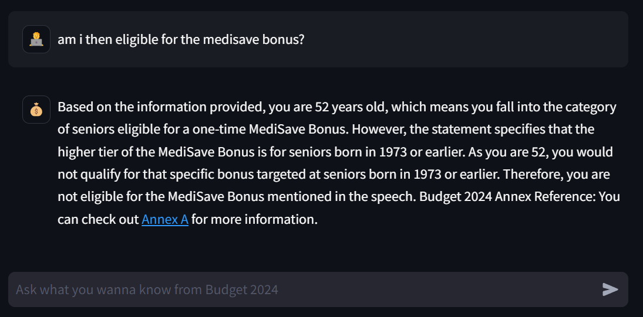
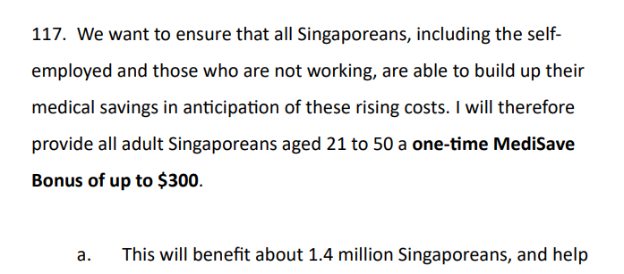
Am I then eligible for the Medisave bonus?
** Similarly, there will be folks who might be curious if they are eligible for the Medisave bonuses.

Slide 8
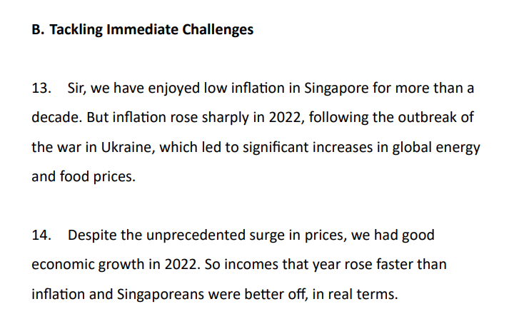
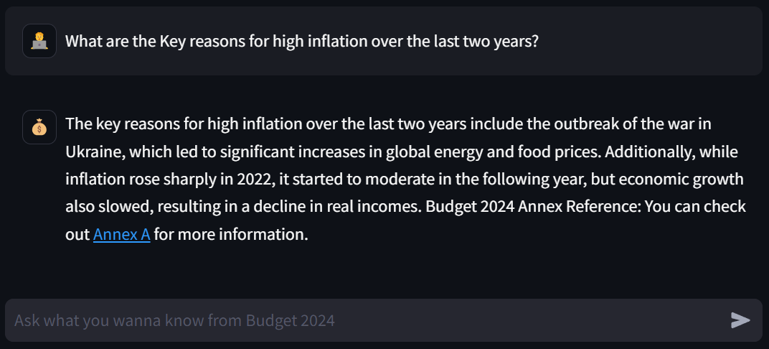
What are the key reasons for high inflation over the last two years?

Slide 9
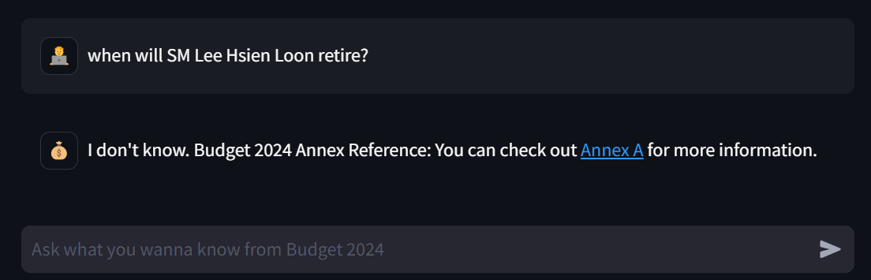
When will SM Lee Hsien Loong retire?

Slide 10
Environment Variable Update to ChatGPT API Key
Change to your own API key under .env file
OPENAI_API_KEY=sk-0Kjov7d_tWiivG5IXUDFhVKcVtneqB6XZ7xMlVdMncT3BlbkFJu50GZWjdrtSvRH8S6QM_nwAaQ1T7Wfc7hyBw85ygkA

Slide 11
How to setup and run the chatbot application

Slide 12
Bonus Feature #2: Comparison of various Chunking Strategies + Rationale for selecting final Approach
The choice of chunking strategy will have significant impact on retrieval performance.
Traditional text splitting methods often break documents at arbitrary points, which will potentially affect the disruption of information flow & context. E.g. Recursive character text split
While using the chunk overlap will help to share some standard text with adjacent chunks, the cut-off point between two meaningful chunks needed more structural/empirical method to evaluate. I considered playing with this chunkviz to explore the tradeoffs https://chunkviz.up.railway.app/
So, we consider using semantic chunking to split text at a more natural breakpoints so that it can preserve the semantic coherence within each chunk.
Empirical evaluated performance

Slide 13
Bonus Feature #3: Chat Streaming Effect
Show code + video/gif
done

Slide 14
Bonus Feature #4: Hosting on Cloud

